Slide 1

Assignment 2 Concept: Marine Environment Monitoring
Frank Walsh
IoT Standards and Protocols 2024

Slide 2

Overview
A marine environment monitoring and logging solution.
“Prototypical” solution
Focus on Data Collection, Communication, IoT infrastructure solution.
Scope out some physical aspects(Marine grade housing, marine deployment)

Slide 3
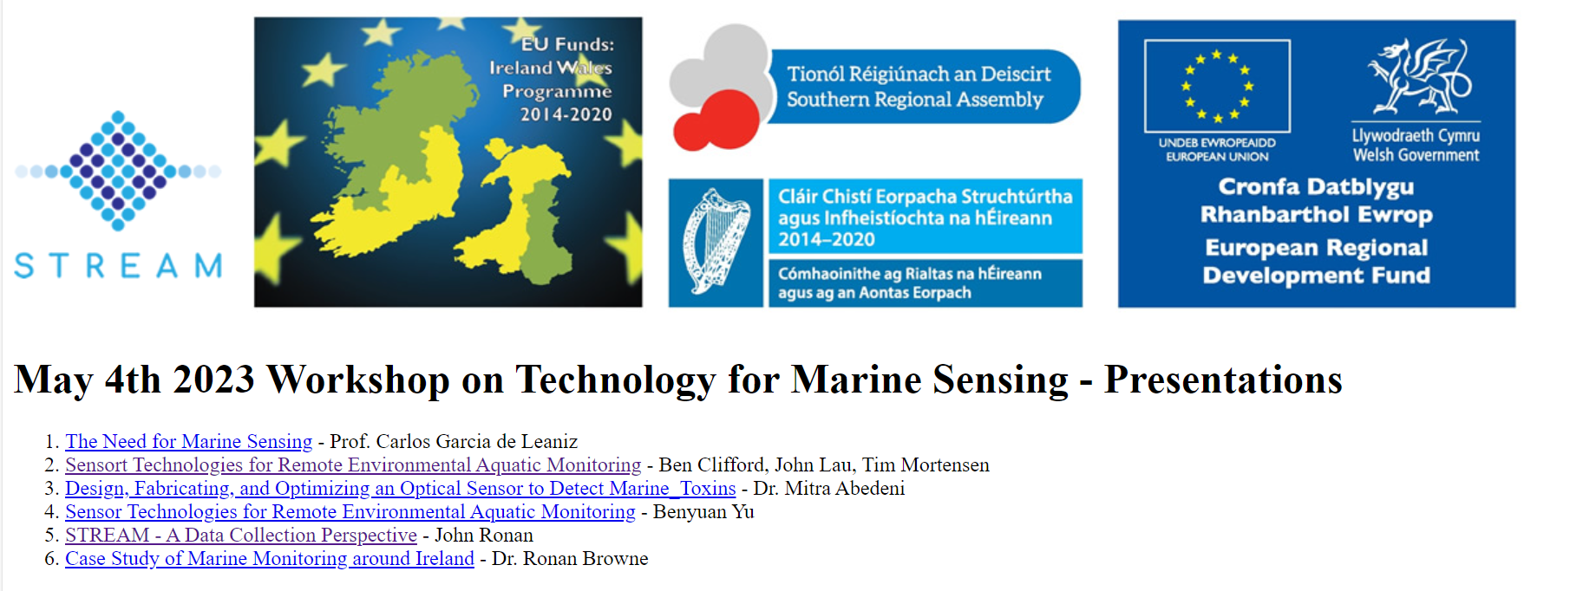
Motivation

Slide 4



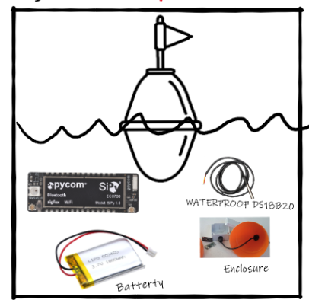










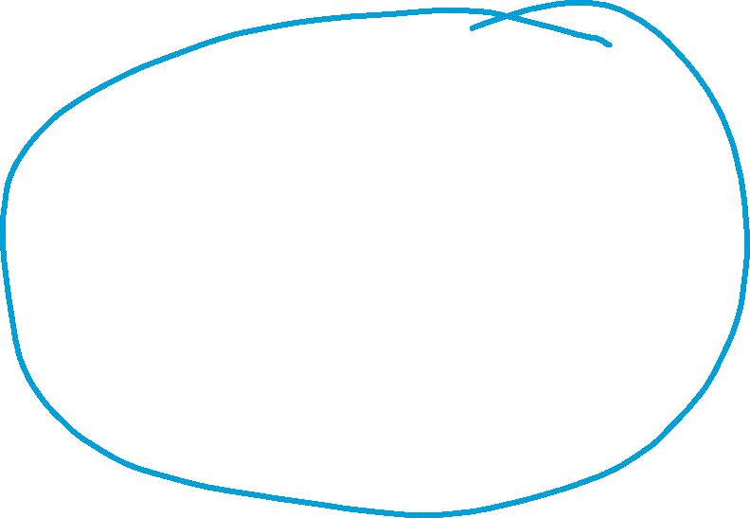


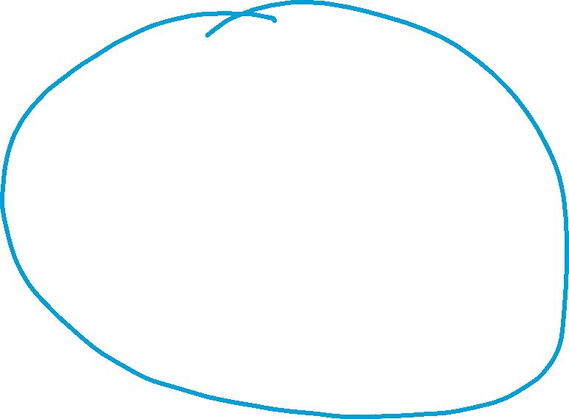

Overview of potential solution
Data Collection/Aggregation
Sensor Layer
Application/ Dashboarding
Data Storage

Slide 5
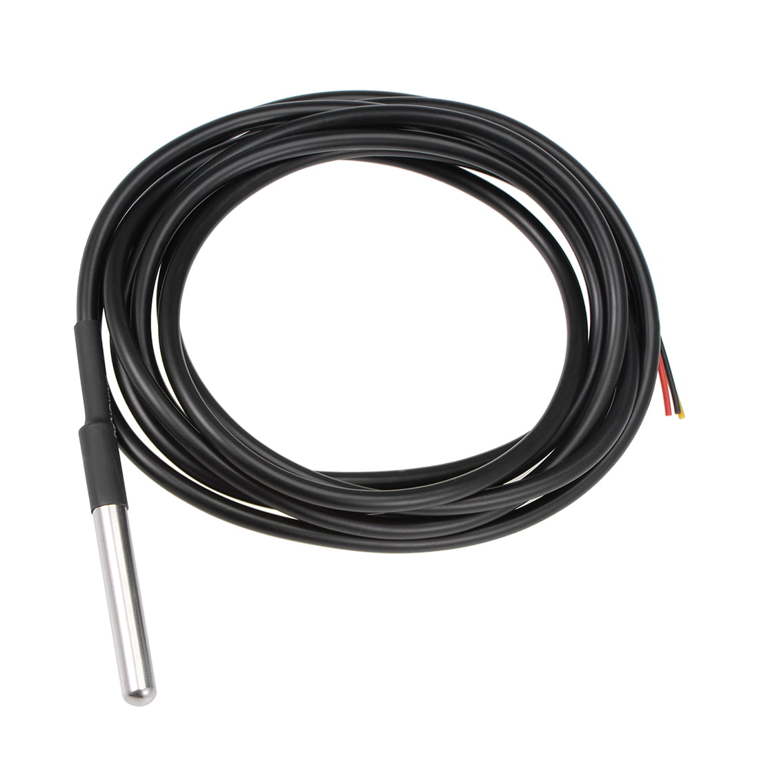
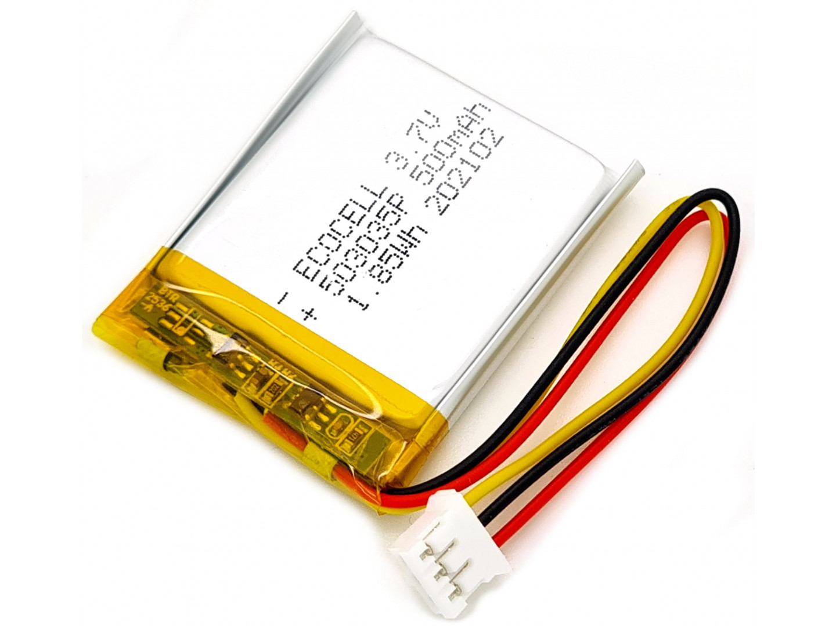
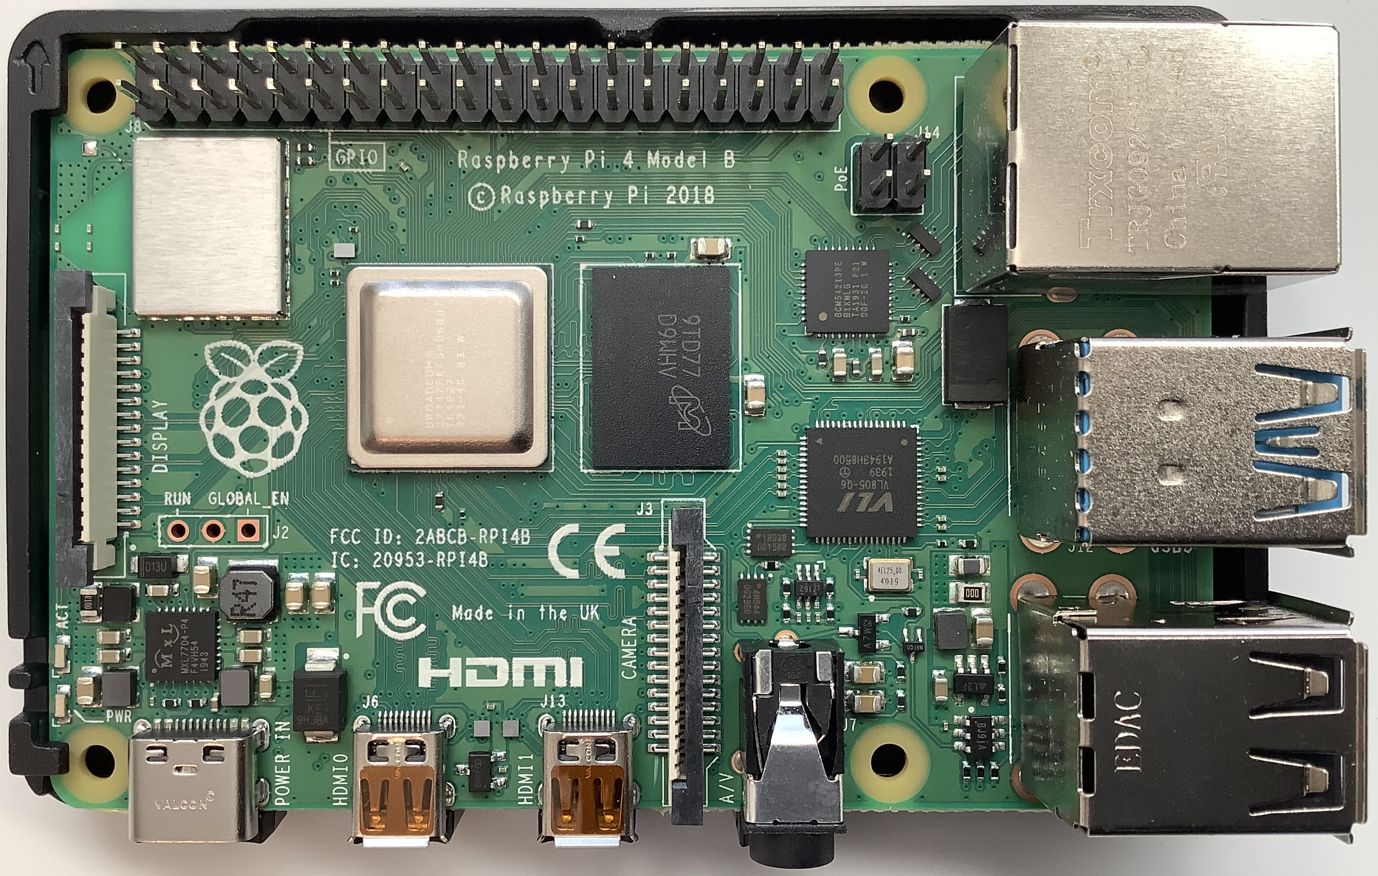
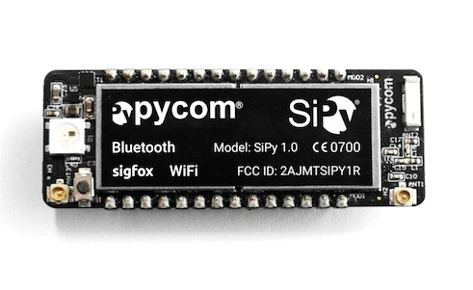
1. Sensor/Data Collection Layer
Sensor
Type: Waterproof Digital Temperature sensor (expandable to other environmental metrics in future iterations).
Connection: Wired connection to the MCU/SBC.
Data Format: Numeric temperature data in Celsius.
MCU/SBC
Type: Network-capable MCU/SBC (e.g., RPi, PyCom SiPy/LoPy, ESP32, STM32 with LoRa module, ).
Functionality:
Collects data from the digital sensor.
Processes the data (e.g., averages, timestamping).
Sends data via LPWAN/Wireless protocol.

Slide 6
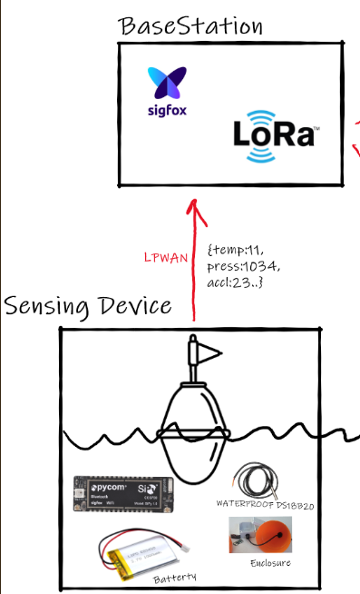
2. Remote Device Connectivity
LPWAN
Type: LoRaWAN, Sigfox, or NB-IoT
Wifi
Bluetooth/Zigbee
Selection based on availability, coverage, range power consumption, and data transmission needs.
Functionality: Transmit sensor data from the Collection device to base station/Gateway device.

Slide 7
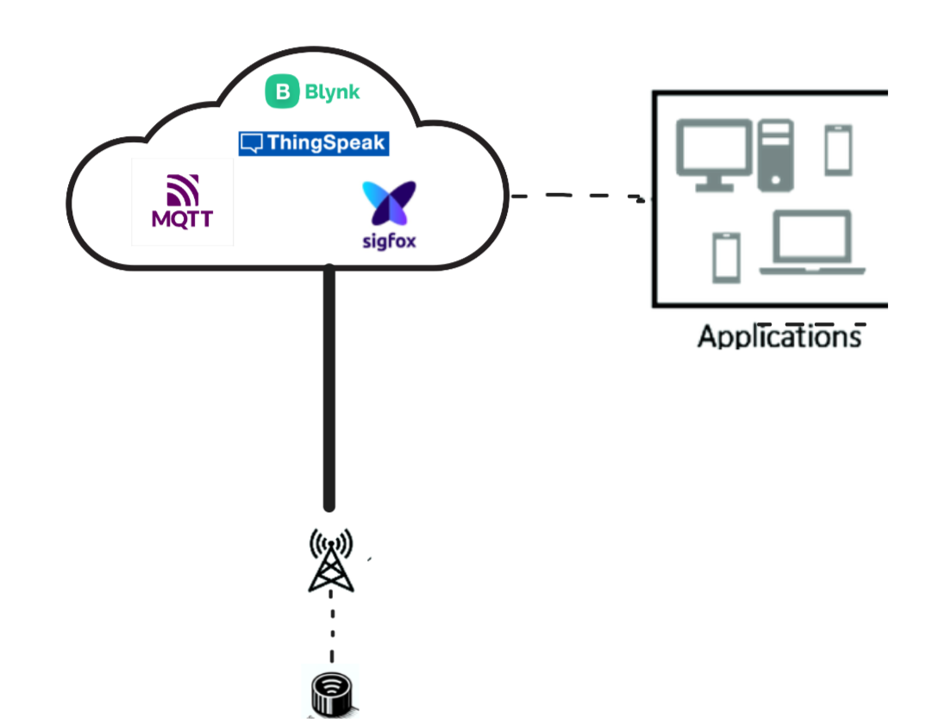
3. Data Collection/ Aggrigation
Base Station/Gateway
Receives data transmitted over LPWAN/ Other Wireless Network
Transmits to Cloud Platform/MQTT broker
RESTful API providing data access/ingestion(web hook for other services)
Publishing Process
Consumes data from the RESTful API.
Publishes data to a MQTT broker(or other IoT messaging platform) for real-time updates.
Stores data in DB(time-series or other) for historical analysis and trend monitoring.

Slide 8
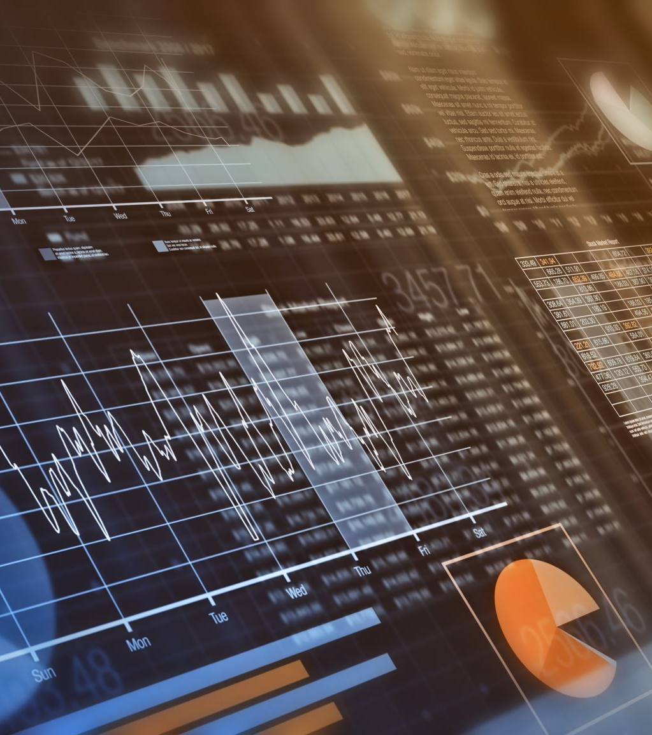
4. Applications/Dashboarding
Grafana
Data visualisation.
Provides dashboards for real-time and historical data analysis.
Blynk
Utilized for developing a mobile app.
Offers a user-friendly interface for (pseudo) real-time monitoring and control over the system.
Third Party Service integration

Slide 9
Design Considerations:
The following should be included in design:
Scalable: Design the system with scalability in mind, allowing for easy integration of additional sensors, and collection devices.
Expandable: design for future integration of additional environmental data and sensors (e.g., pH, salinity) without major changes
Secure: Implement secure data transmission protocols (remember TLS and message encryption for MQTT)
Data Validation: Validate data at collection. Use Timestamping/UIDs for data tracing
Data Analytics: use analytics and machine learning models for predictive maintenance, anomaly detection, and trend forecasting.
UX: Custom alerts, thresholds, and automated actions based on sensor data.

